Slide 1
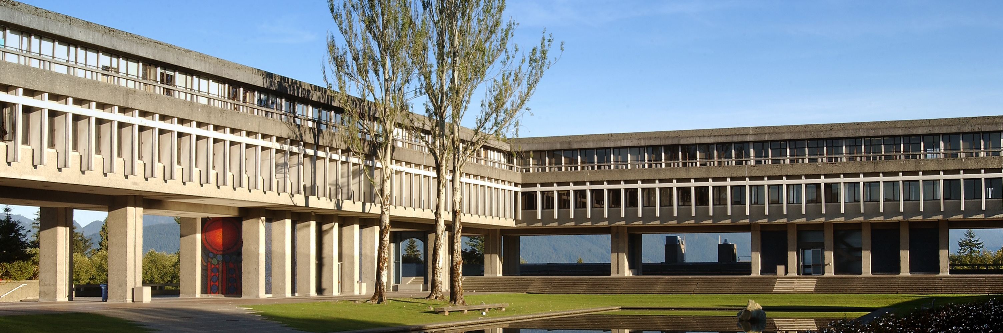

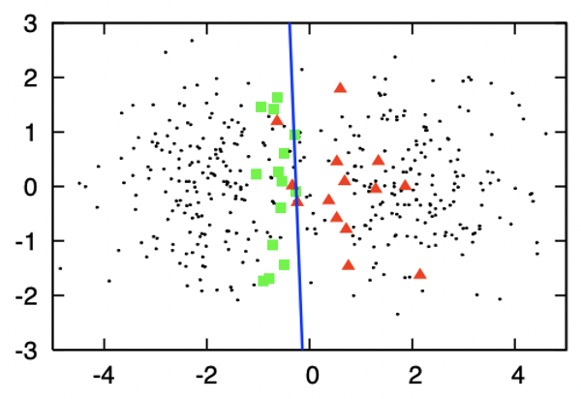
Active Learning: An Exploratory Study of its Application in R
Andy Wang
STAT 403
Project Presentation
Apr 25, 2021

Slide 2
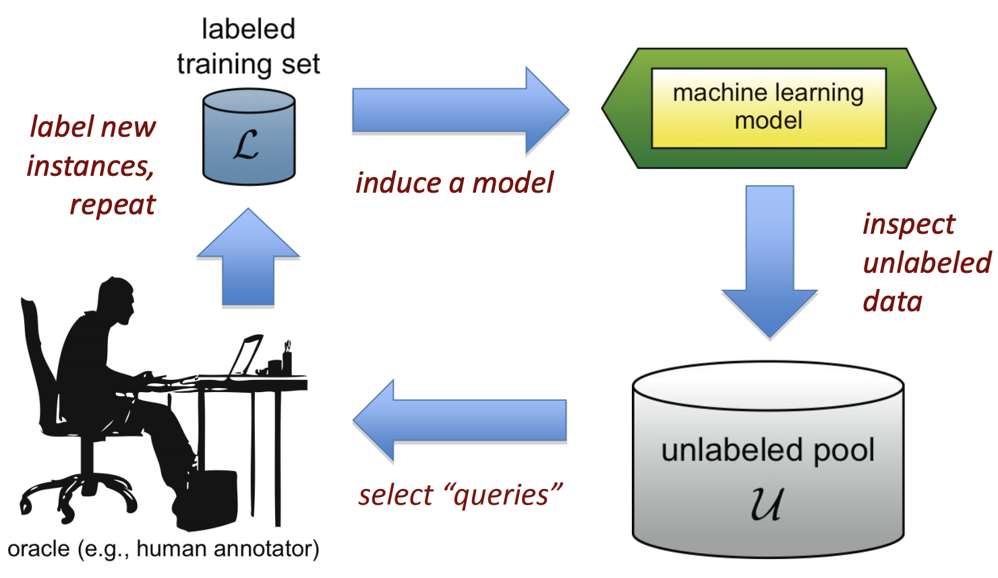
Active Learning (AL)
Background
Objectives
Methods
Results
Conclusion

Slide 3
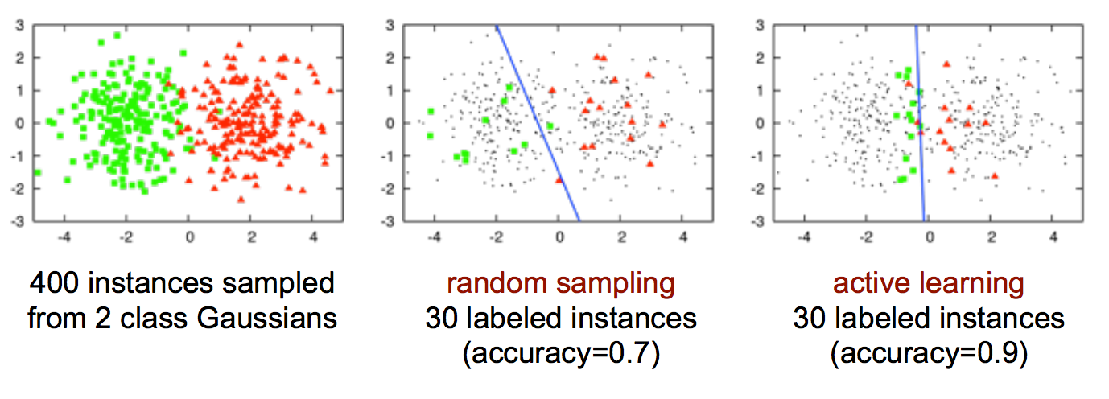
Example 1: Classification
shorturl.at/lmqE0
Background
Objectives
Methods
Results
Conclusion

Slide 4

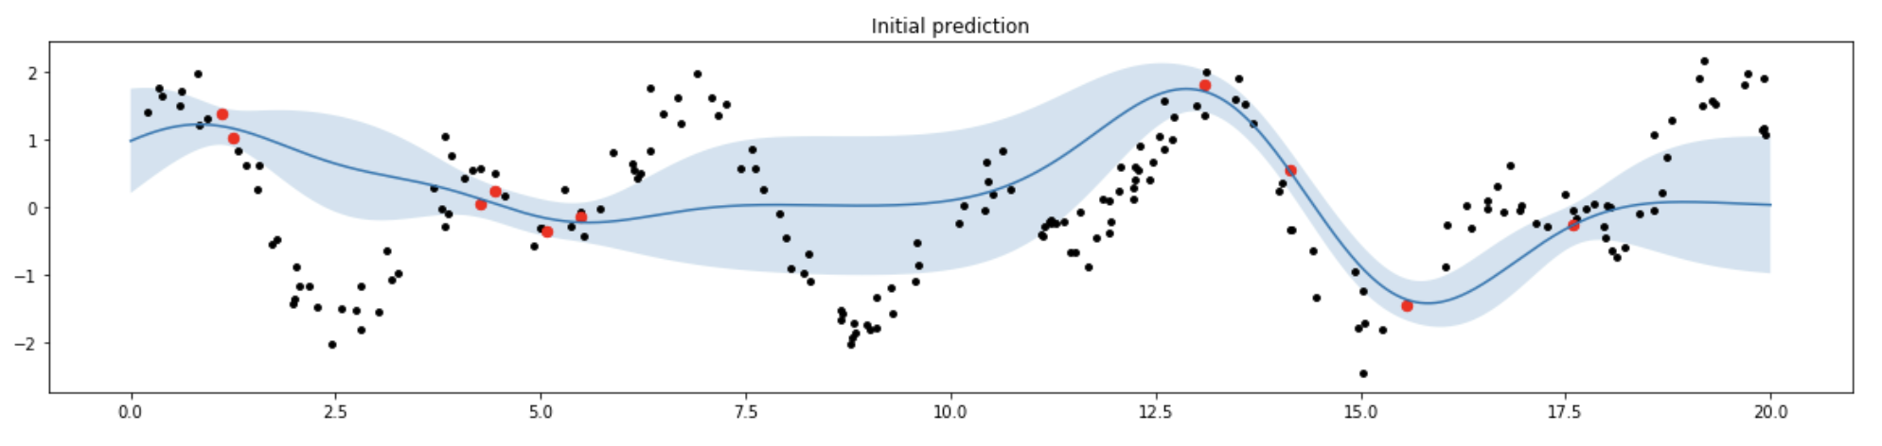

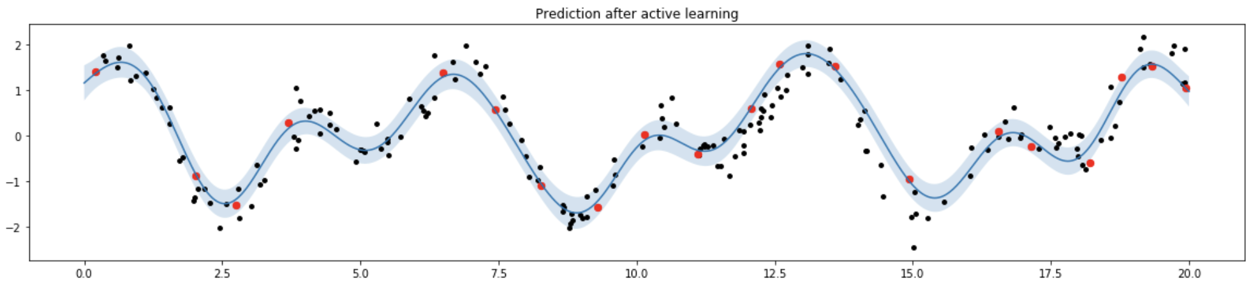
Example 2: Regression
Random:
AL:
Background
Objectives
Methods
Results
Conclusion

Slide 5




Project Objectives
Currently, there is no useable R package for AL
Bring pain for statisticians and students to enter this field
Motivation: Implement a pipeline in R
Evaluate whether R is an appropriate platform for AL
Discover the behavior of AL baseline methods
Explore potential solutions to interesting insights
Alipy, ...
?
Background
Objectives
Methods
Results
Conclusion

Slide 6
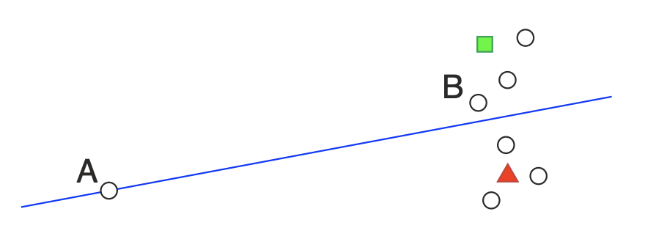
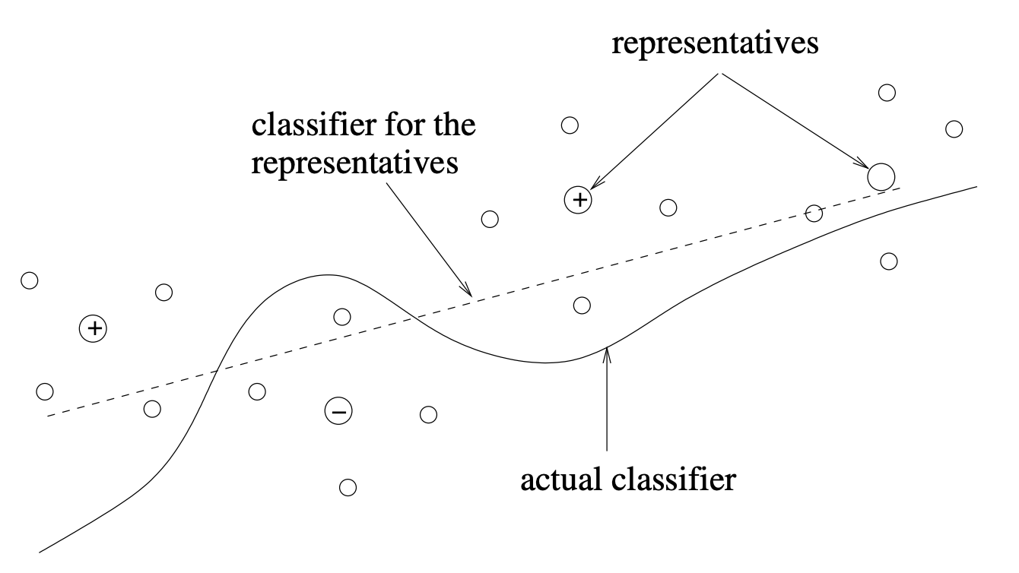
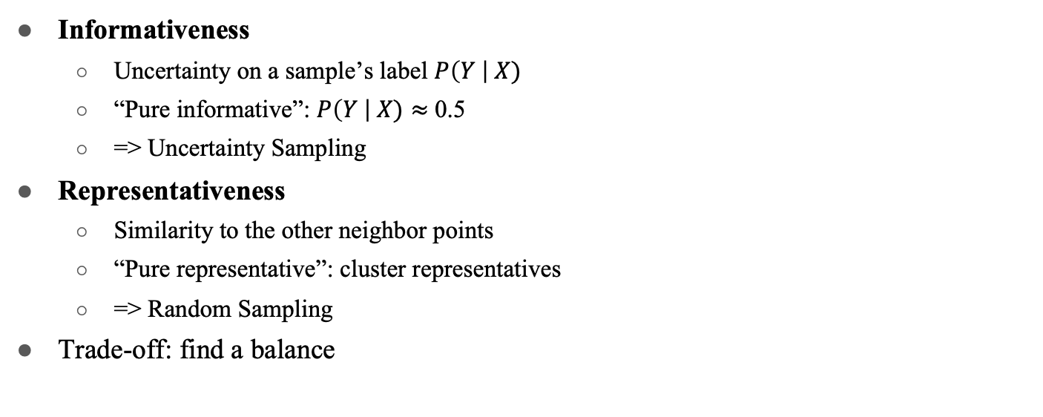
Querying Criteria and Methods
Informativeness
Uncertainty on a sample’s label $P\left(Y \right| X)$
“Pure informative”: $P\left(Y \right| X)≈$ 0.5
=> Uncertainty Sampling
Representativeness
Similarity to the other neighbor points
“Pure representative”: cluster representatives
=> Random Sampling
Trade-off: find a balance
Background
Objectives
Methods
Results
Conclusion
Notes:
Bring this slide to summarize the results

Slide 7
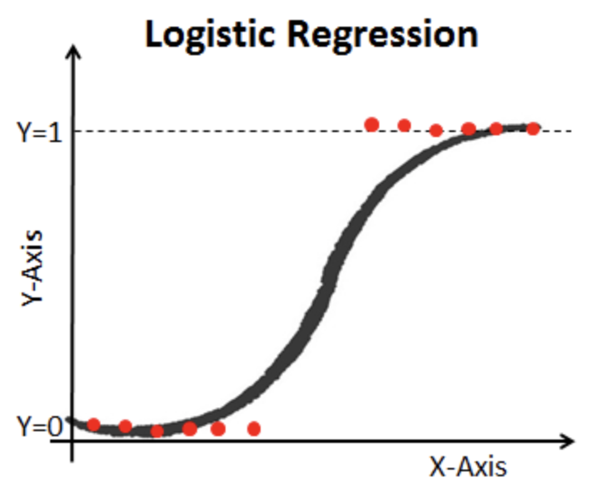
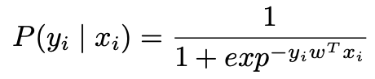
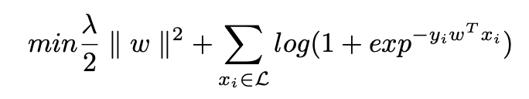
Classifier: Logistic Regression
Posterior Probability
Regularization
Background
Objectives
Methods
Results
Conclusion
Notes:
Bring this slide to summarize the results

Slide 8
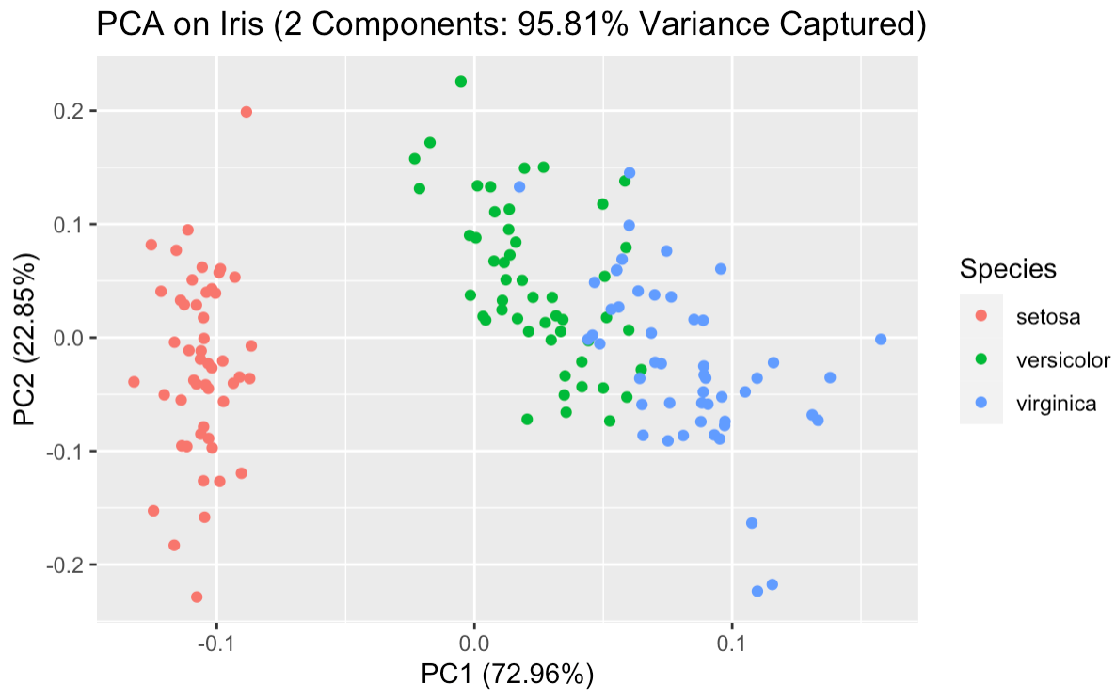
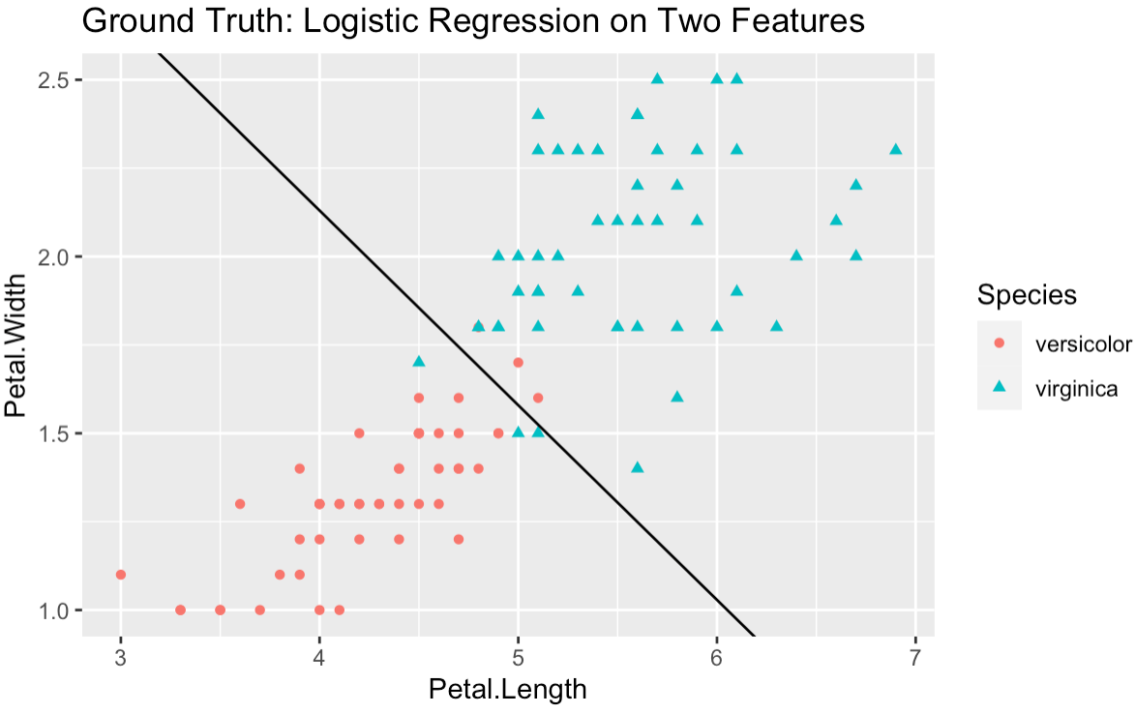
Classification on Iris
Iris: a multivariate flower data set
3 class labels: ‘setosa’ (X1), ‘versicolor’ (X2) and ‘virginica’ (X3)
50 data entries for each group => 150 records in total
X2
X3
X2
X3
X1
Background
Objectives
Methods
Results
Conclusion
Notes:
Different AL algorithms
Along with the accuracy-query plot

Slide 9

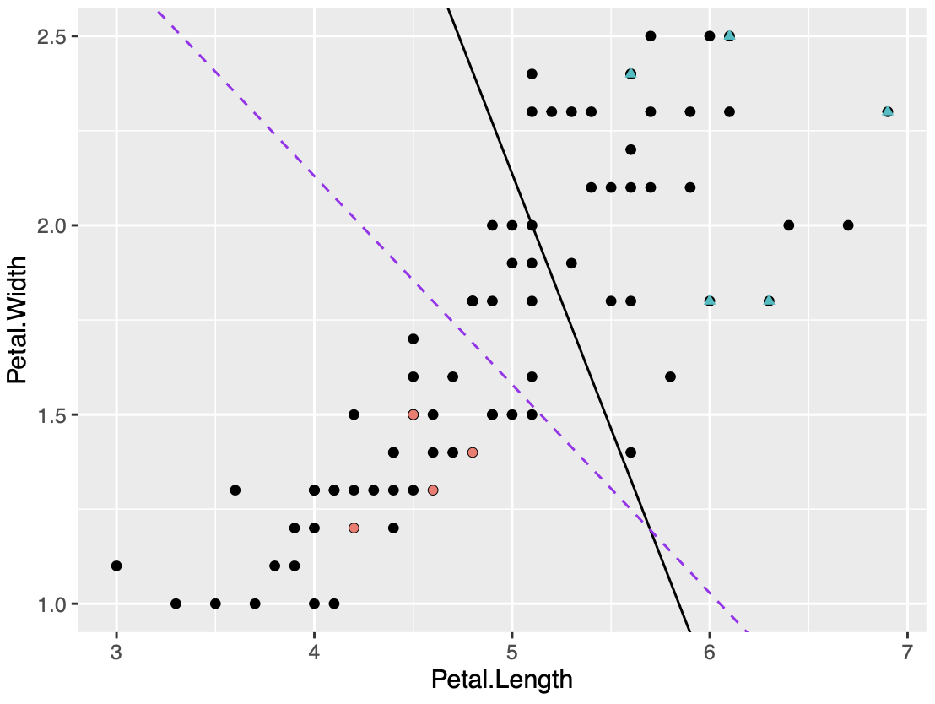
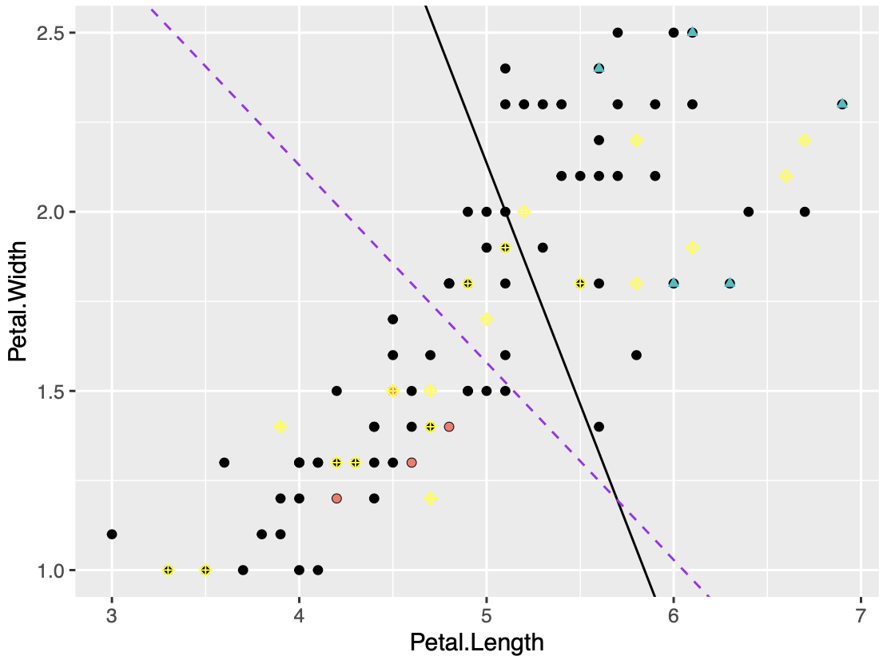
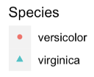
AL Querying Process
Initially, split 100 points to pool set and test set (80:20)
Split the pool to initial training set and unlabeled pool set (10:70)
In each iteration, query a sample using uncertainty sampling and label it (“ ”)
Background
Objectives
Methods
Results
Conclusion

Slide 10
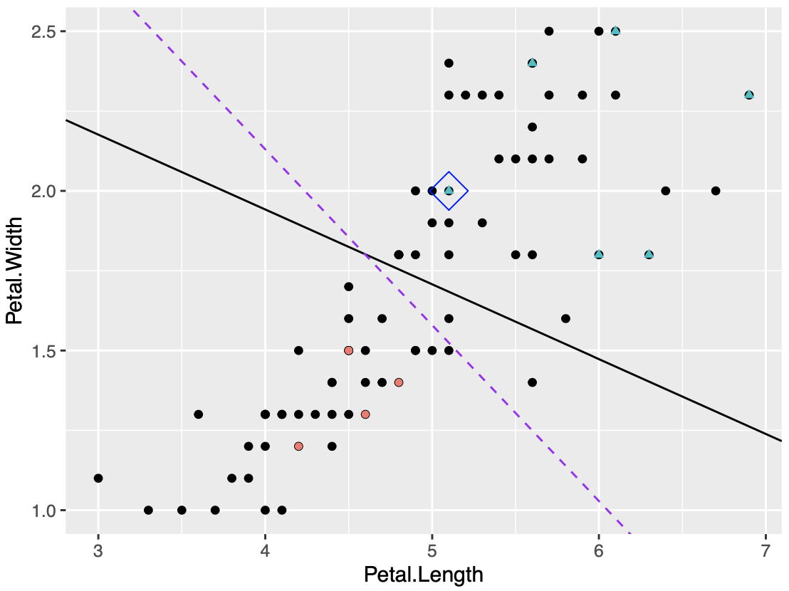
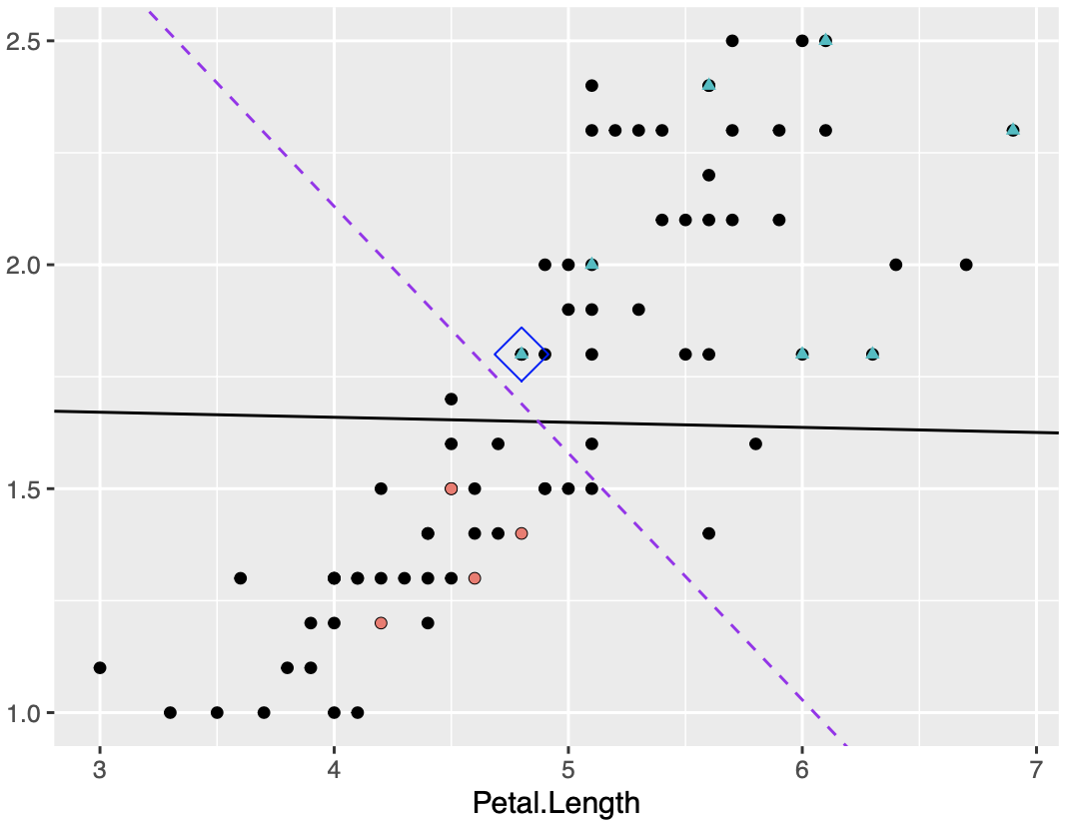
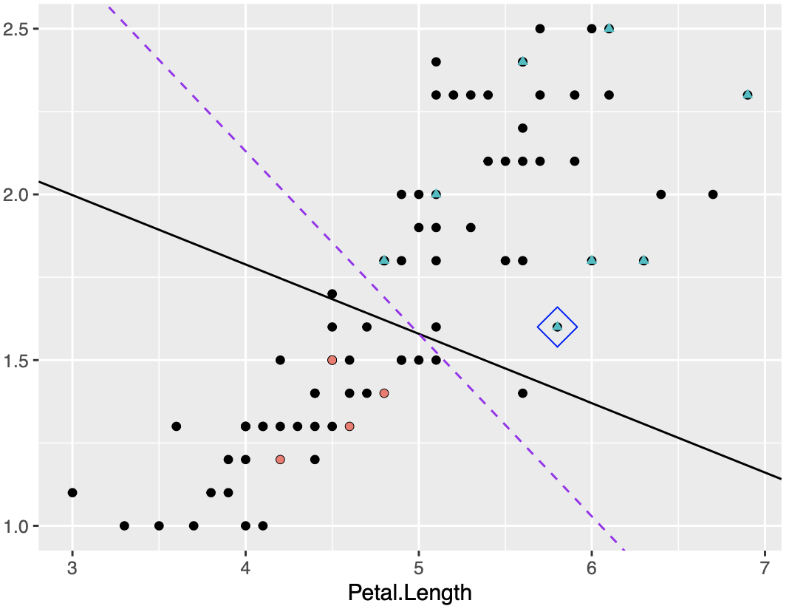
Uncertainty: iterations 1 to 3
Prediction boundary changes dramatically
Background
Objectives
Methods
Results
Conclusion

Slide 11
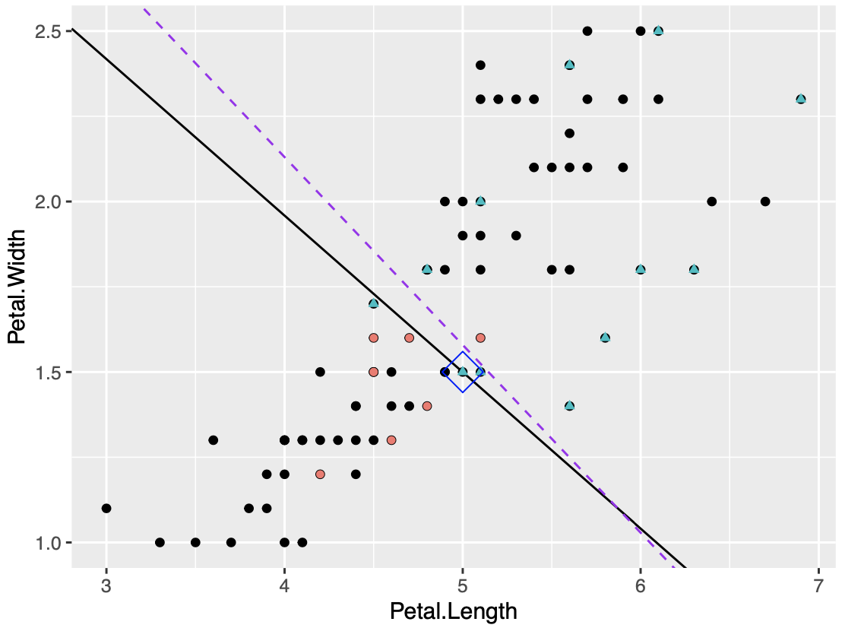
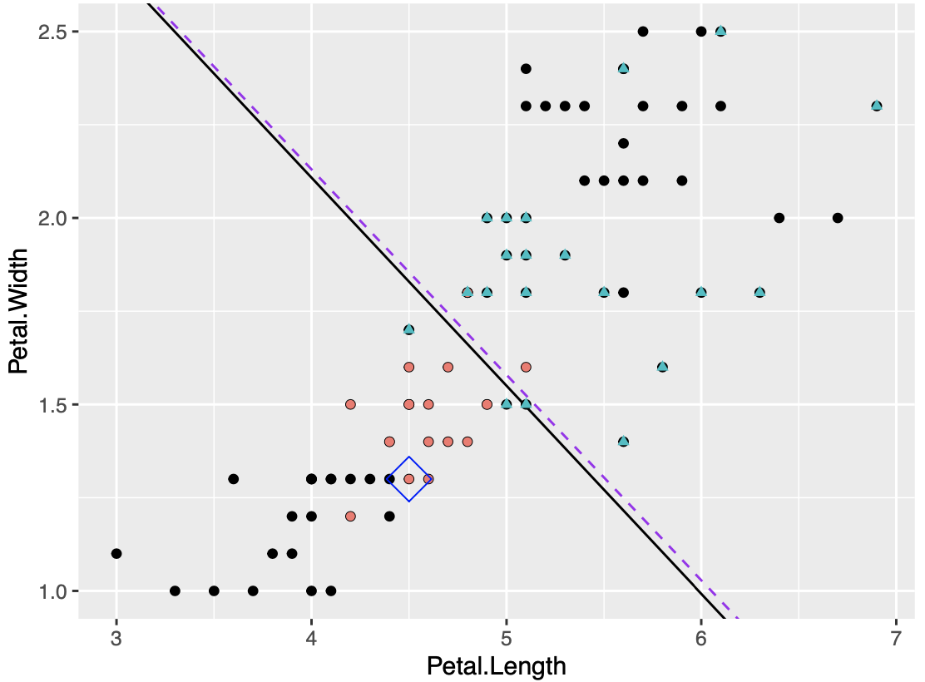
Uncertainty: iterations 10 and 30
Predictions become stable after several queries
Achieve a good model using a much smaller training set
Background
Objectives
Methods
Results
Conclusion

Slide 12
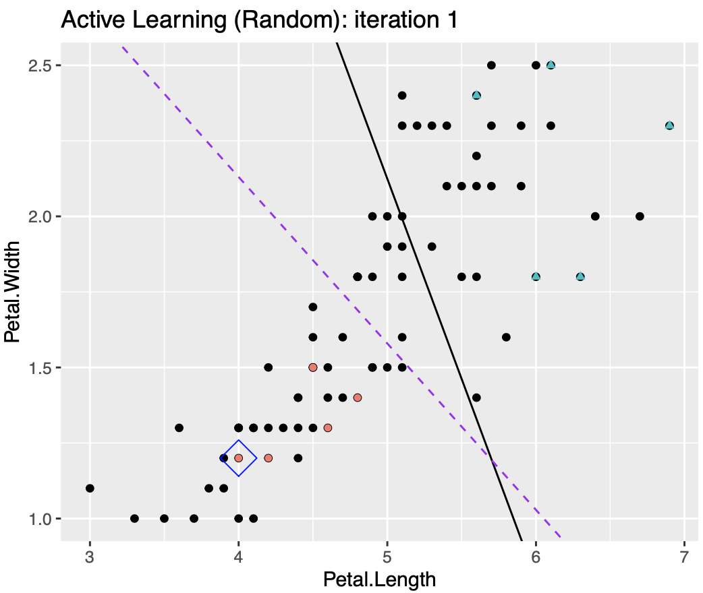
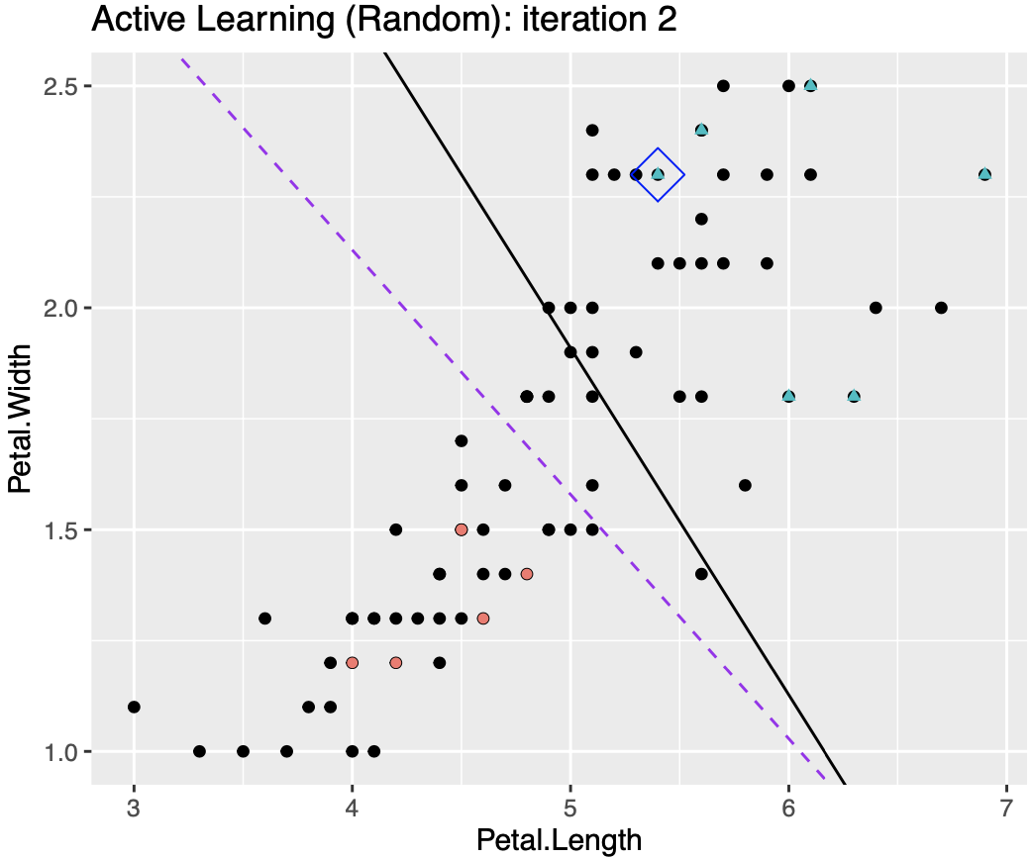
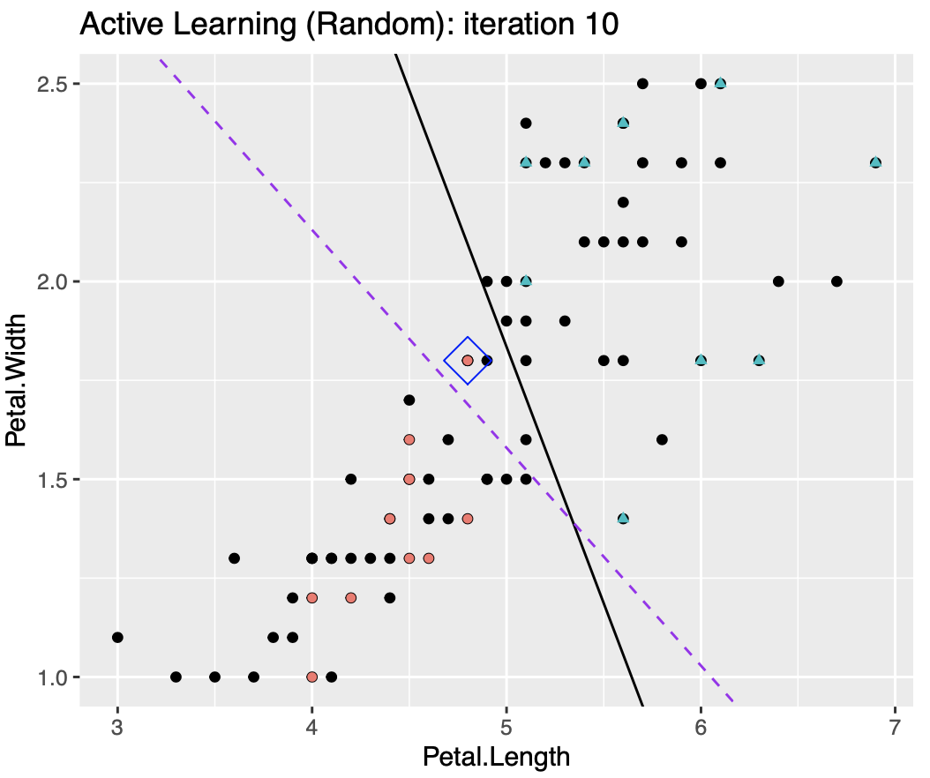
Random: iterations 1, 2, 10
In each iteration, query a sample using random sampling
Prediction boundary changes gradually
Background
Objectives
Methods
Results
Conclusion

Slide 13
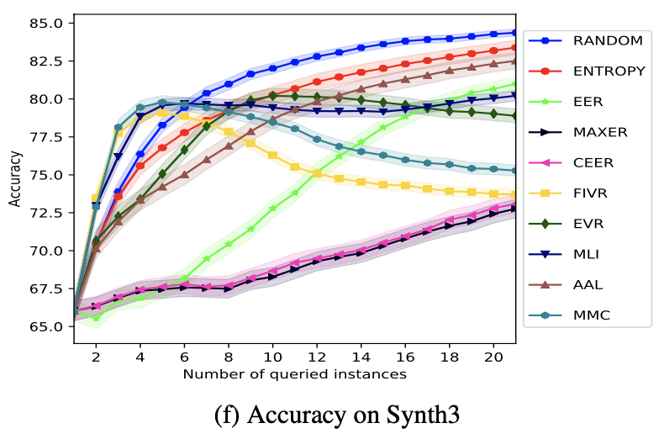
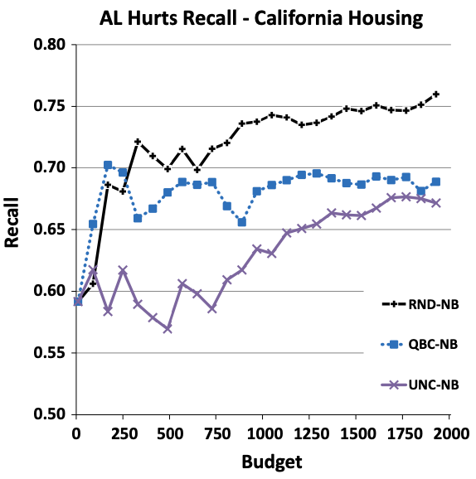
Power of Randomization
Is uncertainty always good than random?
Random is competitive in real-world settings
Yang, et al., (2018)
M. E. Ramirez-Loaiza et al. (2017)
Background
Objectives
Methods
Results
Conclusion

Slide 14
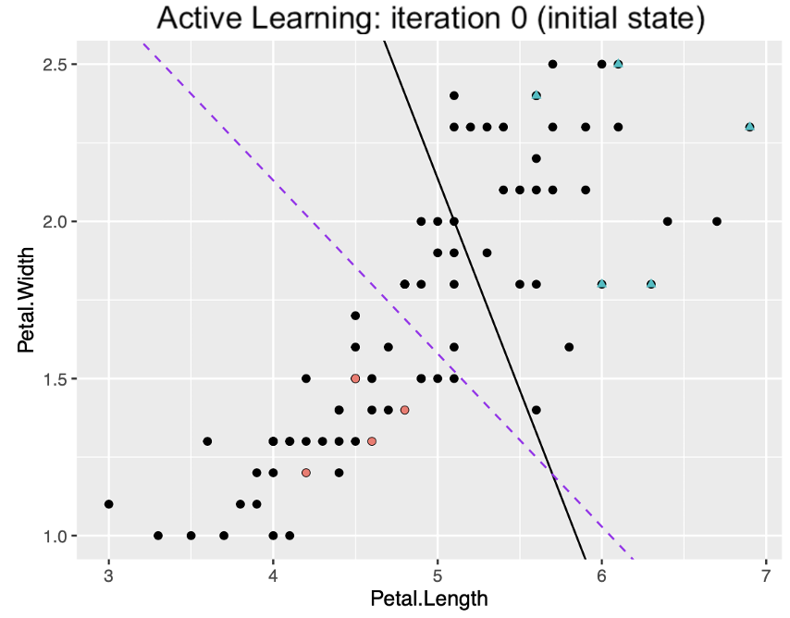
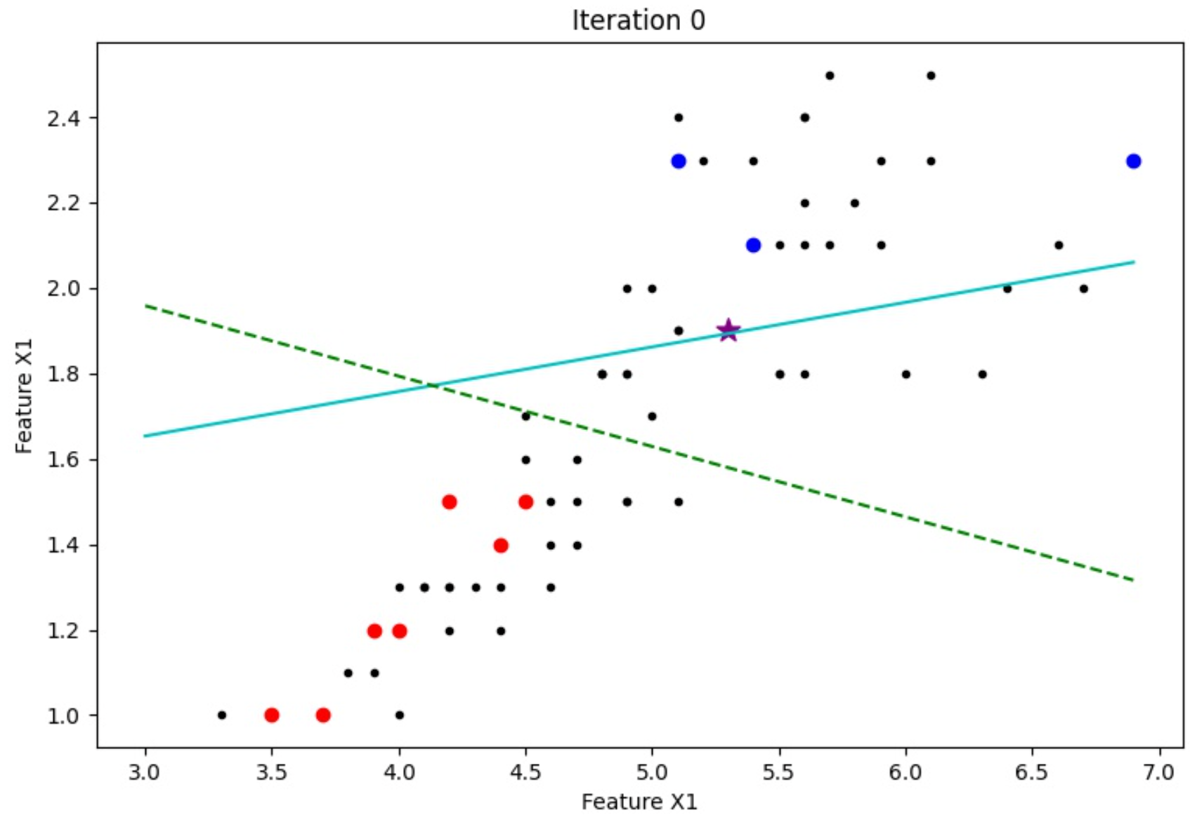
AL: R vs. Python
About ¼ fewer amount of code in Python
No big difference from implementation and results
Why not R?
Background
Objectives
Methods
Results
Conclusion

Slide 15
Conclusion
AL: build a good model using a smaller training set
Develop A simple AL pipeline in R with two baseline methods
Uncertainty Sampling
Random Sampling
Visualization: Uncertainty vs. Random
Observed benefits from randomization in AL
Still an open question to propose a safe method
AL: R vs. Python
Background
Objectives
Methods
Results
Conclusion

Slide 16
Future Directions & Open Questions
On the experiments:
Scalability: test on larger (>2-D) datasets and other classifiers (e.g., SVM)
Implement more AL algorithms, collect them, and develop an R package
On the AL algorithms:
Think about why Random Sampling is such a competitive method
Discover how much degree of randomization is necessary in AL
Extend AL to a multidisciplinary area collaborating with Statistics
Background
Objectives
Methods
Results
Conclusion

Slide 17
Affiliations & Acknowledgments
STAT 403 (Sampling and Experimental Design; Prof. Liangliang Wang)
Sampling: Random Sampling, Uncertainty Sampling
Experiment Design: Optimal Experimental Design
Logistic Regression
Iris Dataset from Tutorial 1
CMPT 419 (Machine Learning; Prof. Greg Mori)
STAT 452 (Statistical Learning; Prof. Tom Loughin)
CMPT 459 (Data Mining; Prof. Martin Ester)

Slide 18
Selected References
Yazhou Yang and Marco Loog. A benchmark and comparison of active learning for logistic regression. Pattern Recognition, 83:401–415, 2018.
Maria Ramirez-Loaiza, Manali Sharma, Geet Kumar, and Mustafa Bilgic. Active learning: an empirical study of common baselines. Data Mining and Knowledge Discovery, 31, 03 2017.
Burr Settles. Active learning literature survey. University of Wisconsin, Madison, 52, 07 2010.
Yao-Yuan Yang, Shao-Chuan Lee, Yu-An Chung, Tung-En Wu, Si-An Chen, and Hsuan-Tien Lin. libact: Pool- based active learning in python. Technical report, National Taiwan University, 10 2017. available as arXiv preprint https://arxiv.org/abs/1710.00379.

